Slide 1
Balancing sustainability and quality care: Can we go green and save money?

Slide 2
Today’s speaker
Fiona Brazill
Head of Proposition for Sustainability
and Net Zero
2024
2050
Net Zero: where are we today?
Notes:
TALK HERE ABOUT THE NET ZERO CHALLENGE.
To understand the Net Zero concept, the definition is: Net Zero means 90% reduction in scope 1, 2, 3 emissions by 2050 and the last 10% can be neutralised using carbon removal offsets, e.g. planting trees, improving biodiversity.
The UK government commitments on public buildings ae a 50% reduction in carbon emissions by 2032, 75% by 2037 and Net Zero by 2050.
If you similarly setup your initial plan and baseline data, then you can gradually
embed the culture and practices in your schools settings.
in future reporting cycles you can develop your reputation as an established Climate active school and work towards
a long-term Net Zero schools estate and your final 10% of carbon emissions can be dealt with by either carbon offsetting or carbon insetting. Offsetting is essentially buying carbon credits, insetting is making further reductions within your supply chain to achieve the final 10%

Slide 3
Provision across the care estate
1,283,000
£36,000
Range £13k to £91k
Service Users:
Cost per Service User
Care Homes:
10.8%
of total turnover
Older People in Care Home
408,000
Care Homes
Care Homes:
9,680 no.
Housing with Care
144,000
Beds:
412,000
Care at Home
Laing Buisson Research (2024-25)
Notes:
Sources:
Laing Buisson Social Care Costings
£13k for home care through to £91k for specialist care, older people $64k, supported living £55k, average £36k
Trend towards more care at home with increasing population ageing but existing care home buildings – 70% of these buildings will still be here in 2050

Slide 4
Solar savings £45m
15,899,510 kWh Generation
What would Net Zero look like for the care estate?
Generating energy = income & community energy.
Land
=
Site and buildings
Rationalised, Community Energy.
=
Gross Internal Area
=
Rationalised.
Water consumption
Benchmark policy.
=
Energy Consumption
=
-90% and offset/inset 10%.
Knowledgeable about carbon literacy and improved health and wellbeing.
Staff and Residents
=
Power
Generation
Modal shift to +70%.
=
Notes:
Talk through each item
Potential generation in PV over car parks, fuel cell technologies, use of unused land to increase biodiversity, fleet as a service, generate more than required, increase efficiency through battery storage and sell through a virtual arrangement to benefit of local community e.g. Danforth Care Homes combine solar PV energy generation with battery storage, reducing their electricity costs to one-third of that of a non-EPC A care home
Is space fully utilised?
How do they purchase energy, are they getting best rate, consider forming energy clubs for buying power
Offsetting v insetting
Power generation how much are you generating as a % of your consumption.
What is the space utilisation look like, what is your full-time equivalent and cost of heating and lighting these per m2 and per resident so that you are clear which sites are costing you most and therefore where you need to prioritise efficiency measures
What does your water consumption look like, again different fittings will reduce water consumption and the associated water bills.
The care sector’s sickness rate averages 5 days lost to sickness per person, costing over £120m per annum at minimum wage alone
Better ventilation can decrease absenteeism by up to 35%, improve cognitive function by 61%, and boost productivity by 10%
Behavioural Change for Energy Efficiency training can save energy costs of 10 to 25%

Slide 5
How do we achieve Net Zero for care sector estates at
ZERO COST?
Estate and space utilisation.
Reduce energy/heat demand.
Improve land and building fabric and/or systems.
Match renewables on land and sites to your demand.
Match your estate with investment funded Cap-ex free renewable technologies, storage and EV charging.

Slide 6
Investment funded renewable
technologies: How it works
Request your
own personalised calculations.
Retrofit solar battery solution for green assets (PV solar panels, hybrid inverters, batteries and accessories).
+
Advantages of this approach
Costed example:
1
Free installation and maintenance
Off-balance sheet & IFRS16 compliant
Improved EPC ratings
Boosts ESG credentials
Creates new jobs in local community
South West England
Care Home
2
£68k annual saving
20% lower cost
CapEx saving of £560k
360tCO_{2e} annual savings (IFRS S2)
3
4
5
Notes:
Proposed launch 31st March 2024.
Installation from July 2024 for 4 months.

Slide 7
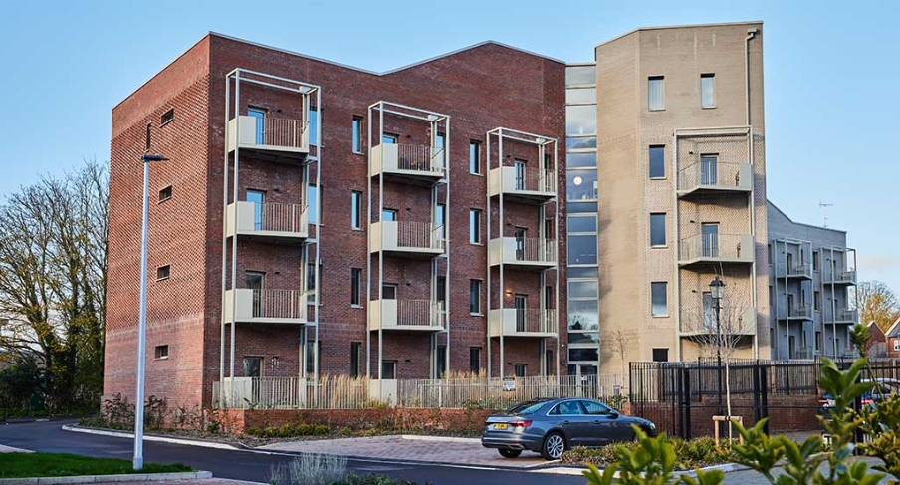
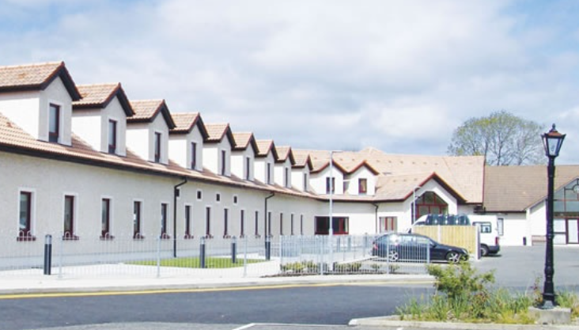
What about new build vs existing?
New-build in Exeter
New-build extension
Notes:
New extension build to higher standards, then retrofit ext building, improve insulation, heating, controls, lighting.
New apartments in Exeter, for Exeter City Council, Designed by Architype, data gathering ongoing, savings of 75% as against a late 70s of early 80s build

Slide 8
Ask yourself…
How aware are you of your energy use and generation, and what steps do you plan to improve these in your efforts towards Net Zero?
What challenges do you see in optimising space and integrating renewables on site?
Notes:
Encourage audience discussion / participation.

Slide 9
Thank you.
Q&A
Fiona Brazill
Head of Proposition for Sustainability
and Net Zero
Request your
own personalised calculations.
Notes:
Q&A
ENCOURAGE FURTHER CONVO WITH LINK TO CONTACT FORM.
Encourage ppl to connect with the team at the event.

