Slide 1


ASTON BROOKE SOLICITORS
Skilled Worker Sponsor licence & Immigration Compliance

Slide 2

ASTON BROOKE SOLICITORS
Aston Brooke is an innovative and niche firm wholly dedicated to the ethical practice of Immigration Law.
The firm specialises in Immigration Compliance and Corporate Immigration Law and Practice.
Aston Brooke is at the forefront in representing the Care Sector in its need for clear and transparent immigration advice.

Slide 3
SPONSORSHIP MANAGEMENT SYSTEM
A main part of the Governments initiative is the Skilled worker route which came into effect from the 1st January 2021. It replaced the previous Tier 2 scheme.
Most businesses using Tier 2 have been able to register as sponsors since February 2008 with the remaining applying since late July 2008.
From November 2008, those who register successfully will be able to sponsor new foreign workers to work in the UK or support those already in the UK who want to stay.

Slide 4
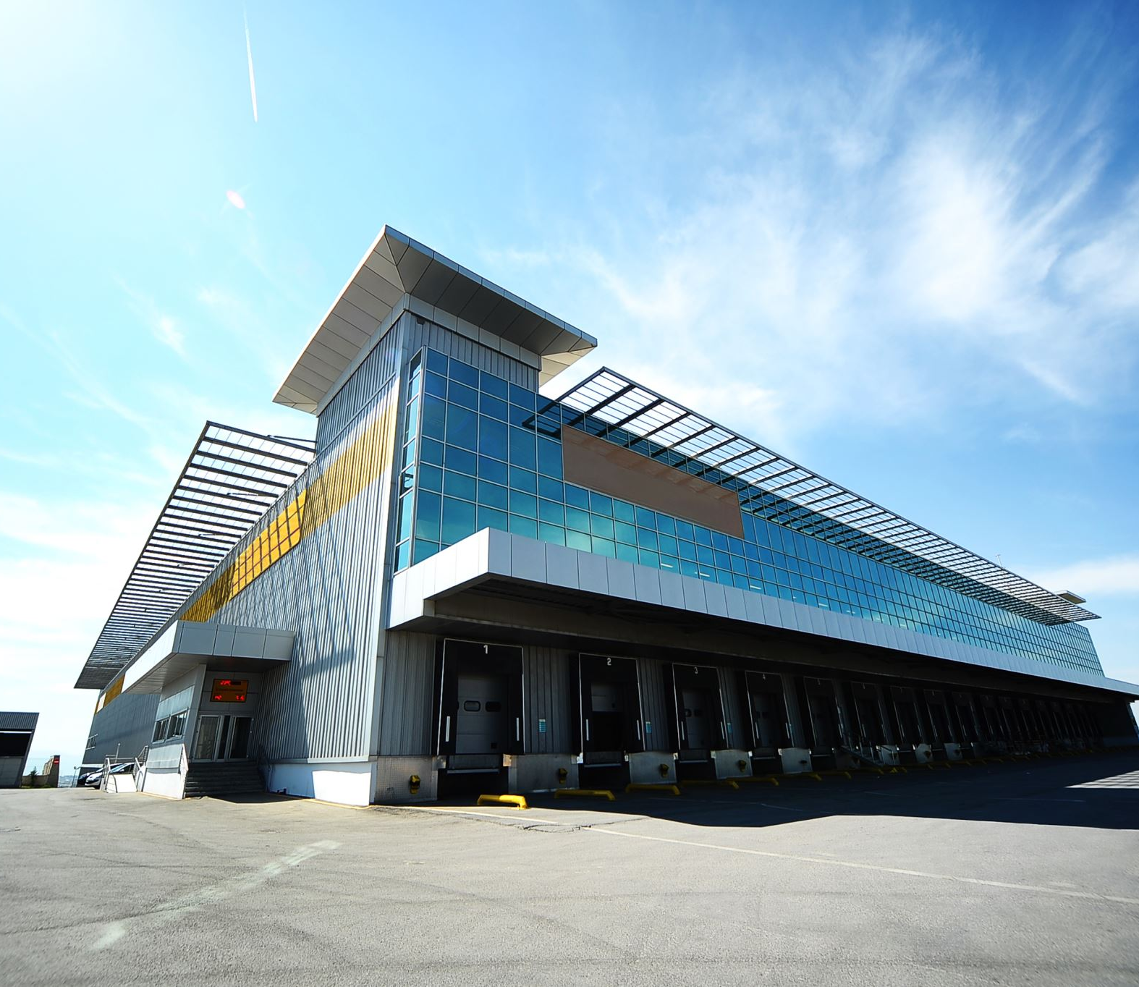
HR IMMIGRATION COMPLIANCE
The Home Office assess five individual areas of your HR systems which are:
Area 1: Monitoring immigration status and preventing illegal employment
Area 2: Maintaining migrant contact details
Area 3: Recordkeeping
Area 4: Migrant tracking and monitoring
Area 5: Recruitment practices and professional accreditations

Slide 5

HOME OFFICE RATING
The Home Office will rate care providers HR systems and compliance from 1 to 3 as follows:
You meet all of the criteria or are fully compliant which results in a “A” rating
You only meet some of the criteria or are partially compliant which results in a “B” rating
You do not meet any of the criteria or are non-compliant.

Slide 6

AUTHORISING OFFICER
The Sponsor organisation must appoint an Authorising Officer who is either the owner, director or someone who has a controlling interest in the business.
Legal representatives cannot become Authorising Officers but can be appointed Level 1 users.
Sponsors are reminded that the username and password are strictly confidential and should never be disclosed to any third party without permission of the Authorising Officer.

Slide 7
Documents Required for the Sponsor Licence Application
1. Certificate of Incorporation
2. CQC certificate
3. Evidence of ownership of the property
4. The last 3 months bank statements
5. Recent Audited or unaudited accounts
6. Employer’s liability insurance certificate
7. Passport copy of the nominated Authorising Officer
8. Account Office and PAYE reference numbers
9. Number of employees

Slide 8
TIMEFRAMES
All Sponsor Licences are decided within 8 weeks from submission of the application.
However, there is a priority service where providers can pay an additional £500 Home Office fee for a decision within 10 working days. However, this is on a lottery basis as the Home Office are only processing 10 cases a day.
A decision will be made with or without conducting a pre-licence visit. Aston Brooke have a good relationship with the majority of the compliance officers.

Slide 9

CURRENT CLIMATE
It is clear that care providers are struggling to recruit and this is due to a combination of factors including low wages, the pandemic and Brexit-related workforce changes.
This is against a backdrop of an increasing number of adults who need support across the country.
The number of sponsor licences have exponentially increased since the introduction of the New Points Based System and Brexit.

Slide 10
COST BENEFITS TO PROVIDERS
Aston Brooke are offering a 20% reduction on professional legal fees to Care England Members.
The firm is also agreeing to undertake a free right to work audit and compliance check. This will ensure that the firm educate providers on their sponsor licence obligations.
This will ensure that providers are fully compliant and not fall foul of the rules and regulations.

Slide 11

BENEFITS TO PROVIDERS
The firm has been dealing with the Home Office for over 15 years and are in contact with senior managers and directors over the years.
The firm have a good communication network with the sponsor compliance team in Sheffield and know nearly all the UKVI compliance officers spread across the UK.
This ensures that sponsor licence applications are successful.

Slide 12
CARE ENGLAND MEMBERS HOLDING A SPONSOR LICENCE
The firm can offer support to providers that currently hold a skilled worker sponsor licence. We will assist with the day- to-day operation of the sponsor licence.
This would include all reporting duties under the sponsor guidance coupled with applications for increase in undefined and defined CoSs and general compliance of the rules.

Slide 13
CARE ENGLAND MEMBERS HOLDING A SPONSOR LICENCE
The firm would also undertake some due diligence on members exiting sponsor licences and check that all the sites/work locations fall under the licence as this is a common issue.
Moreover, not reporting delayed start dates and other change of circumstances has caused sponsors to either lose their licence or a downgrade to a B rating.

Slide 14
CARE ENGLAND MEMBERS HOLDING A SPONSOR LICENCE
It is important to note that migrants cannot work full-time at any other site outside the homes listed under the respective licence.
The only caveat is that the migrant can work 20 hours per week with another company as long as they are undertaking the same job role/duties as stated on the CoS.
There will be no charge for this piece of work.

Slide 15
AB ONLINE CASE MANAGEMENT SYSTEM
The firm commissioned an immigration online case management system which ensured care providers were fully compliant under the points based system.
This system has been vetted and demonstrated to the UKVI who have confirmed that it complies with all the sponsorship duties.
It takes the burden of sponsorship compliance off the shoulders of care providers and my firm deal with every aspect of immigration compliance. We believe that members will benefit from the system as it adheres to all five areas of sponsor duties as set out in the sponsor

Slide 16
ASTON BROOKE SOLICITORS SERVICES
Assist Employers in applying for a Sponsor Licence
Legal representation on Compliance Audits
Pre-audit Compliance Checks
On-Line Case Management Solution
Training Courses across the UK for Immigration Compliance
Prepare all SKILLED WORKER /extension applications for the sector
Recruitment of Staff

Slide 17
ASTON BROOKE SOLICITORS
Mr Kashif Majeed
Email: km@astonbrooke.co.uk
Tel: 0203 4754321
www.astonbrooke.co.uk

