Slide 1

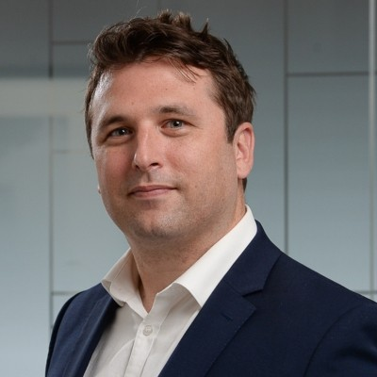
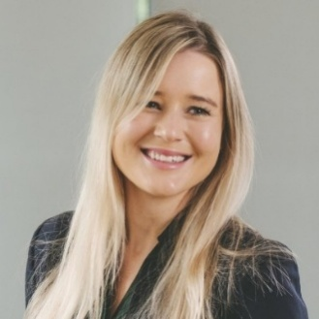
Maximising value in care home sales: Why vendor due diligence matters more than ever
Paul Krivosic
Partner
Kim Lindsay-Smith
Principal Associate

Slide 2

Key terms
1. | Due diligence
2. | Vendor due diligence What is the difference between DD and VDD?
3. | Virtual data room
4. | Due diligence questionnaire
5. | Bi-lateral sale
6. | Auction sale
7. | Scope
2)
Value for money
Our experienced team delivers high-quality work at regional rates, avoiding the risks of under-resourced, junior-led deals.
4)

Slide 3



It’s all in the prep….
Preparation for both bi-lateral sale and auction sales are similar, both require:
Populated and well-ordered VDR
Complete due diligence questionnaire
Focus on areas which will be of the most interest to a buyer (i.e. real estate, regulatory, employment).

Slide 4
Typical bi-lateral sale process
Buyer’s eye review
VDR prepared and populated
DDQ complete
Buyer and its advisers granted access to the VDR
Buyer completes its due diligence process. Disclosure process commences
Buyer and its advisers raise further enquiries following due diligence process
Disclosure process

Slide 5
Vendor due diligence
VDR prepared and populated
DDQ complete
Scope to be agreed with Seller’s advisers
Seller’s advisers prepare vendor due diligence report
Issues identified and potential remedies discussed/implemented
VDD report finalised
Seller’s advisers raises further enquiries
VDD report shared with bidders
Bidders given access to VDR

Slide 6
Pros and cons of VDD
Cons
Cost (adviser and operational)
Availability of resource
Time consuming
Vendor fatigue
Incomplete or inaccurate information
Shelf life
Pros
Preserve price
Controlling the narrative
Opportunity to identify risk and rectify issues
Insight into fundamental issues which may be raised

Slide 7

Auction process v bi-lateral
Auction process: | Multiple potential buyers invited to bid Various stages involved Seller leads on documents Vendor due diligence Longer process
Bi-lateral process: | One buyer from the outset Buyer usually leads on documents Buyer conducts own due diligence Quicker more efficient process
What are we seeing in the market?

Slide 8


Practical tips
Adequately and appropriately resourced
Confidentiality
Good advisers
Well populated VDR with accurate and up to date information
Remedying issues (that are capable of remedy) as soon as possible
Being open and honest
Providing as much information as possible

Slide 9

Questions?

Slide 10


Get in touch
Paul Krivosic
Partner
T: +441214568318
M: +447823748700
E: paul.krivosic@mills-reeve.com
Kim Lindsay-Smith
Principal Associate
T: +441603693361
M: +447341549721
E: kim.lindsay-smith@mills-reeve.com

